Slide 1

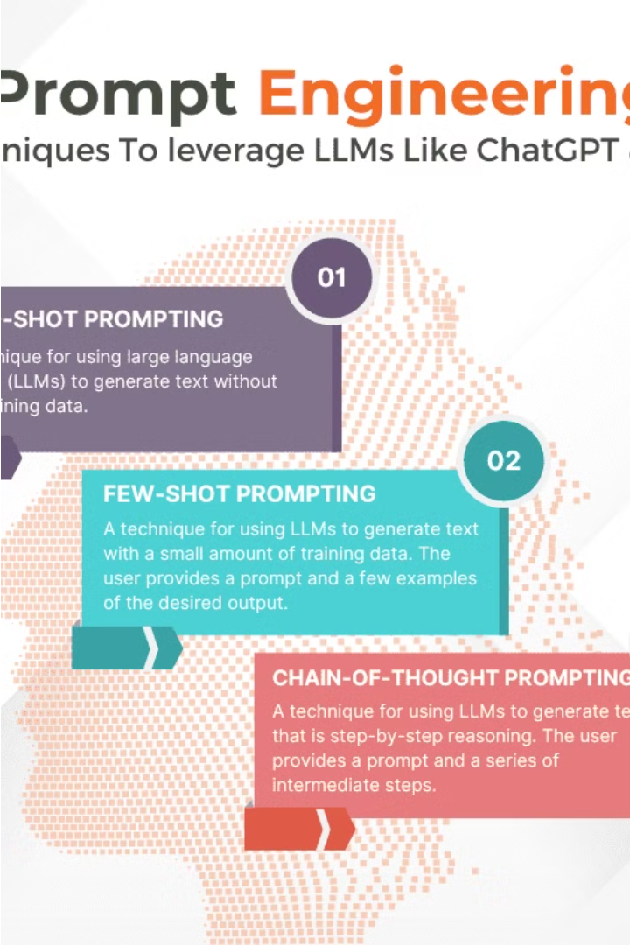

Prompt Engineering Techniques
Prompt engineering is a powerful technique for training and leveraging AI models to perform a wide range of tasks. This presentation will explore three key prompt engineering techniques: Zero-Shot Learning, Few-Shot Learning, and Chain-of-Thought Prompting. Each of these approaches offers unique advantages and applications in areas like text classification, language translation, and decision-making.
by Claire Rebecca

Slide 2
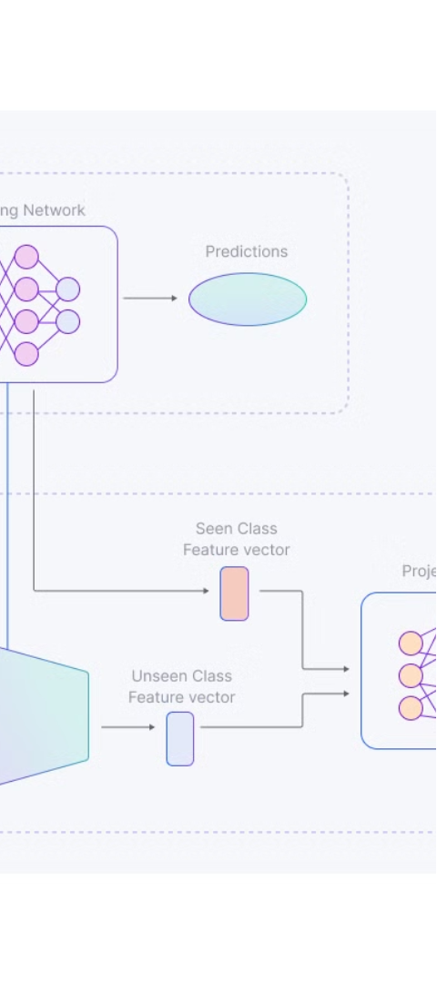
Zero-Shot Learning
1
Description
Zero-shot learning involves training models to perform tasks without explicit supervision or specific examples for each task category. Instead, models learn to generalize from related tasks or contexts.
2
Applications
Text Classification: Classifying text into multiple categories without explicitly training on each category.
Language Translation: Translating languages where the model may encounter unseen word combinations.
Answer Generation: Generating responses to questions without prior training on those exact questions.

Slide 3
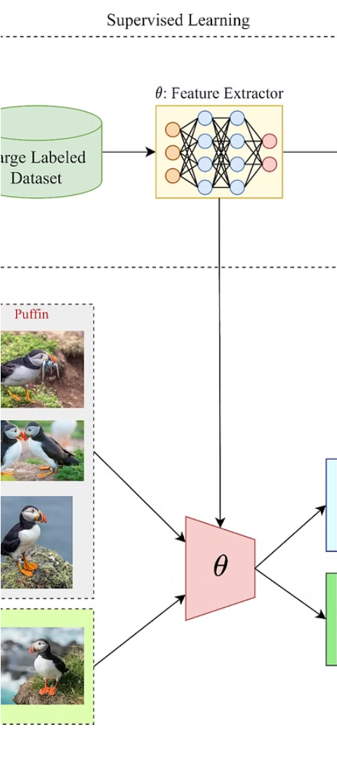
Few-Shot Learning
1
Description
Few-shot learning involves training models with very few examples per class, usually much fewer than what traditional supervised learning requires.
2
Applications
Text Generation: Generating coherent text with limited input or context.
Image Recognition: Identifying objects or scenes with minimal training examples.
Anomaly Detection: Detecting outliers or unusual patterns with sparse labeled data.

Slide 4
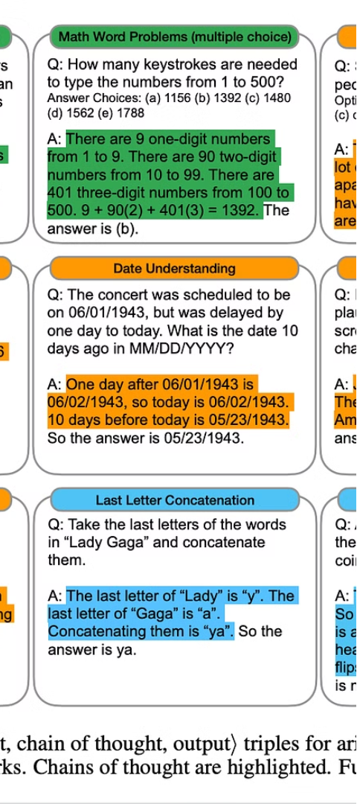
Chain-of-Thought Prompting
1
Description
Chain-of-thought prompting involves sequentially guiding a model through a series of prompts or questions where each step builds on the previous response.
2
Applications
Conversational Agents: Creating more engaging and contextually relevant conversations.
Creative Writing: Generating narratives or stories that follow a logical sequence.
Decision Making: Assisting in complex decision-making processes by iteratively refining inputs.

Slide 5

Explaining Quantum Entanglement
Zero-Shot Prompt
Few-Shot Prompt
Chain-of-Thought Prompt
Prompt: "Explain quantum entanglement."
Prompt: "Explain quantum entanglement using these terms: 'superposition', 'spooky action at a distance', and 'quantum states'."
Prompt 1: "What is quantum entanglement?"
Prompt 2: "How does quantum entanglement relate to the concept of superposition?"
Prompt 3: "Can you explain how 'spooky action at a distance' plays a role in quantum entanglement?"

Slide 6
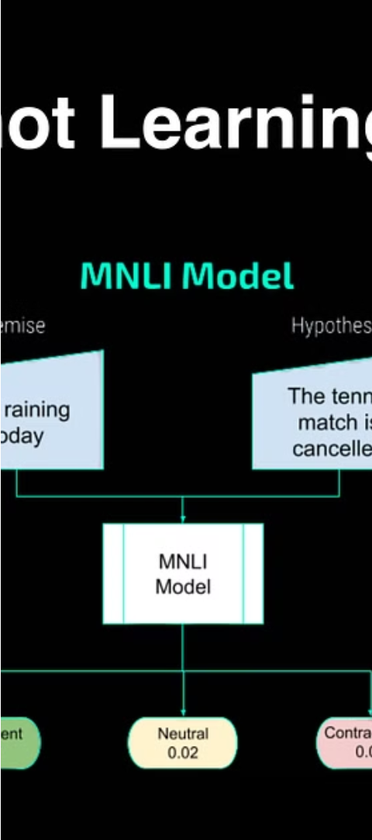
Zero-Shot Response Analysis
1
Evaluate the response's accuracy, completeness, and coherence based on the model's intrinsic understanding of physics concepts.

Slide 7

Few-Shot Response Analysis
1
Compare the quality and depth of explanation between zero-shot and few-shot prompts.
Assess whether incorporating specific terms improves the response.

Slide 8
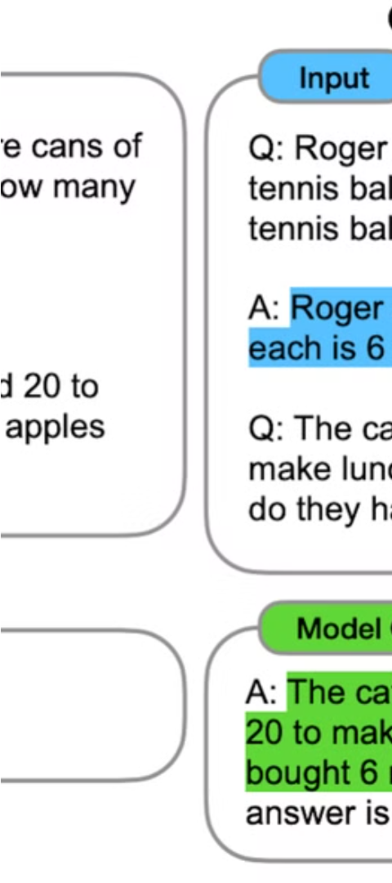
Chain-of-Thought Response Analysis
1
Analyze how the AI connects the dots between prompts, observing the continuity and logical progression in the explanation.
Observations
Effectiveness: Determine which prompt type yields the most accurate and comprehensive explanation of quantum entanglement.
Limitations: Identify any instances of misunderstanding, inaccuracies, or gaps in knowledge that the AI exhibits across different prompt types.

